Slide 1
MORSE CODE ESCAPE GAME
Ella Conley, Tyler Nguyen, Siara Patel, Nathan Strahs

Slide 2



GOAL
Problem: Imagine you are trapped in a jail cell, and the only way to escape is to communicate a signal via morse code to Professor Kirby on the outside of your cell. When you give the signal, Professor Kirby will bust down the walls and help you escape, but she can only understand correct morse code signals. Before you can give the signal, you need to practice to make sure you can do it.
Your job: Given a word on your handy FPGA, input the correct morse code sequence, proving to yourself that you are a MMC (master morse coder).
Applications: Education- User can practice morse code patterns, Communication- more easily + efficiently translate streams of dots and dashes they receive
Notes:
Naton

Slide 3
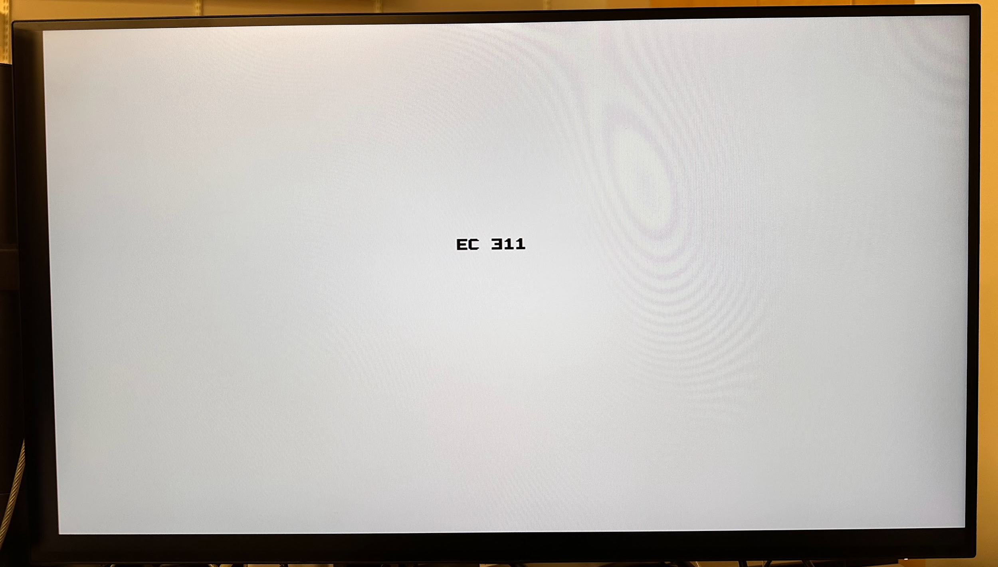
FUNCTIONALITY
Practice Mode
User enters sequence of dots and dashes then presses done
Letter displays on the screen
Escape Game Mode
Monitor will display a word
You will enter the morse code sequence on your FPGA
Press done when you are finished with a letter
The Monitor will light up Green or Red if you are correct or incorrect
You will either become an MMC or botch your escape attempt
Notes:
Siara

Slide 4
SPECIFICATIONS
Morse Code Specifics:
Morse code input (four buttons) → dash, dot, done, reset → Inputs translated to ASCII value → VGA modules receive ASCII letter value
VGA Specifics:
X and Y → defines the pixel count and the position of the pixel
VGA Controller module cycles through the entire screen and checks if in the valid region for the letter to display
Output → Video_on when pixel counts are within the set display area
Letter sets the ascii character and the corresponding address from the ascii_rom module
Ascii_bit_on → depends on ascii_bit which is set by the address of the pixels for each letter
If video_on and ascii_bit_on → rgb is set (output for VGA)
Notes:
Siara P.

Slide 5
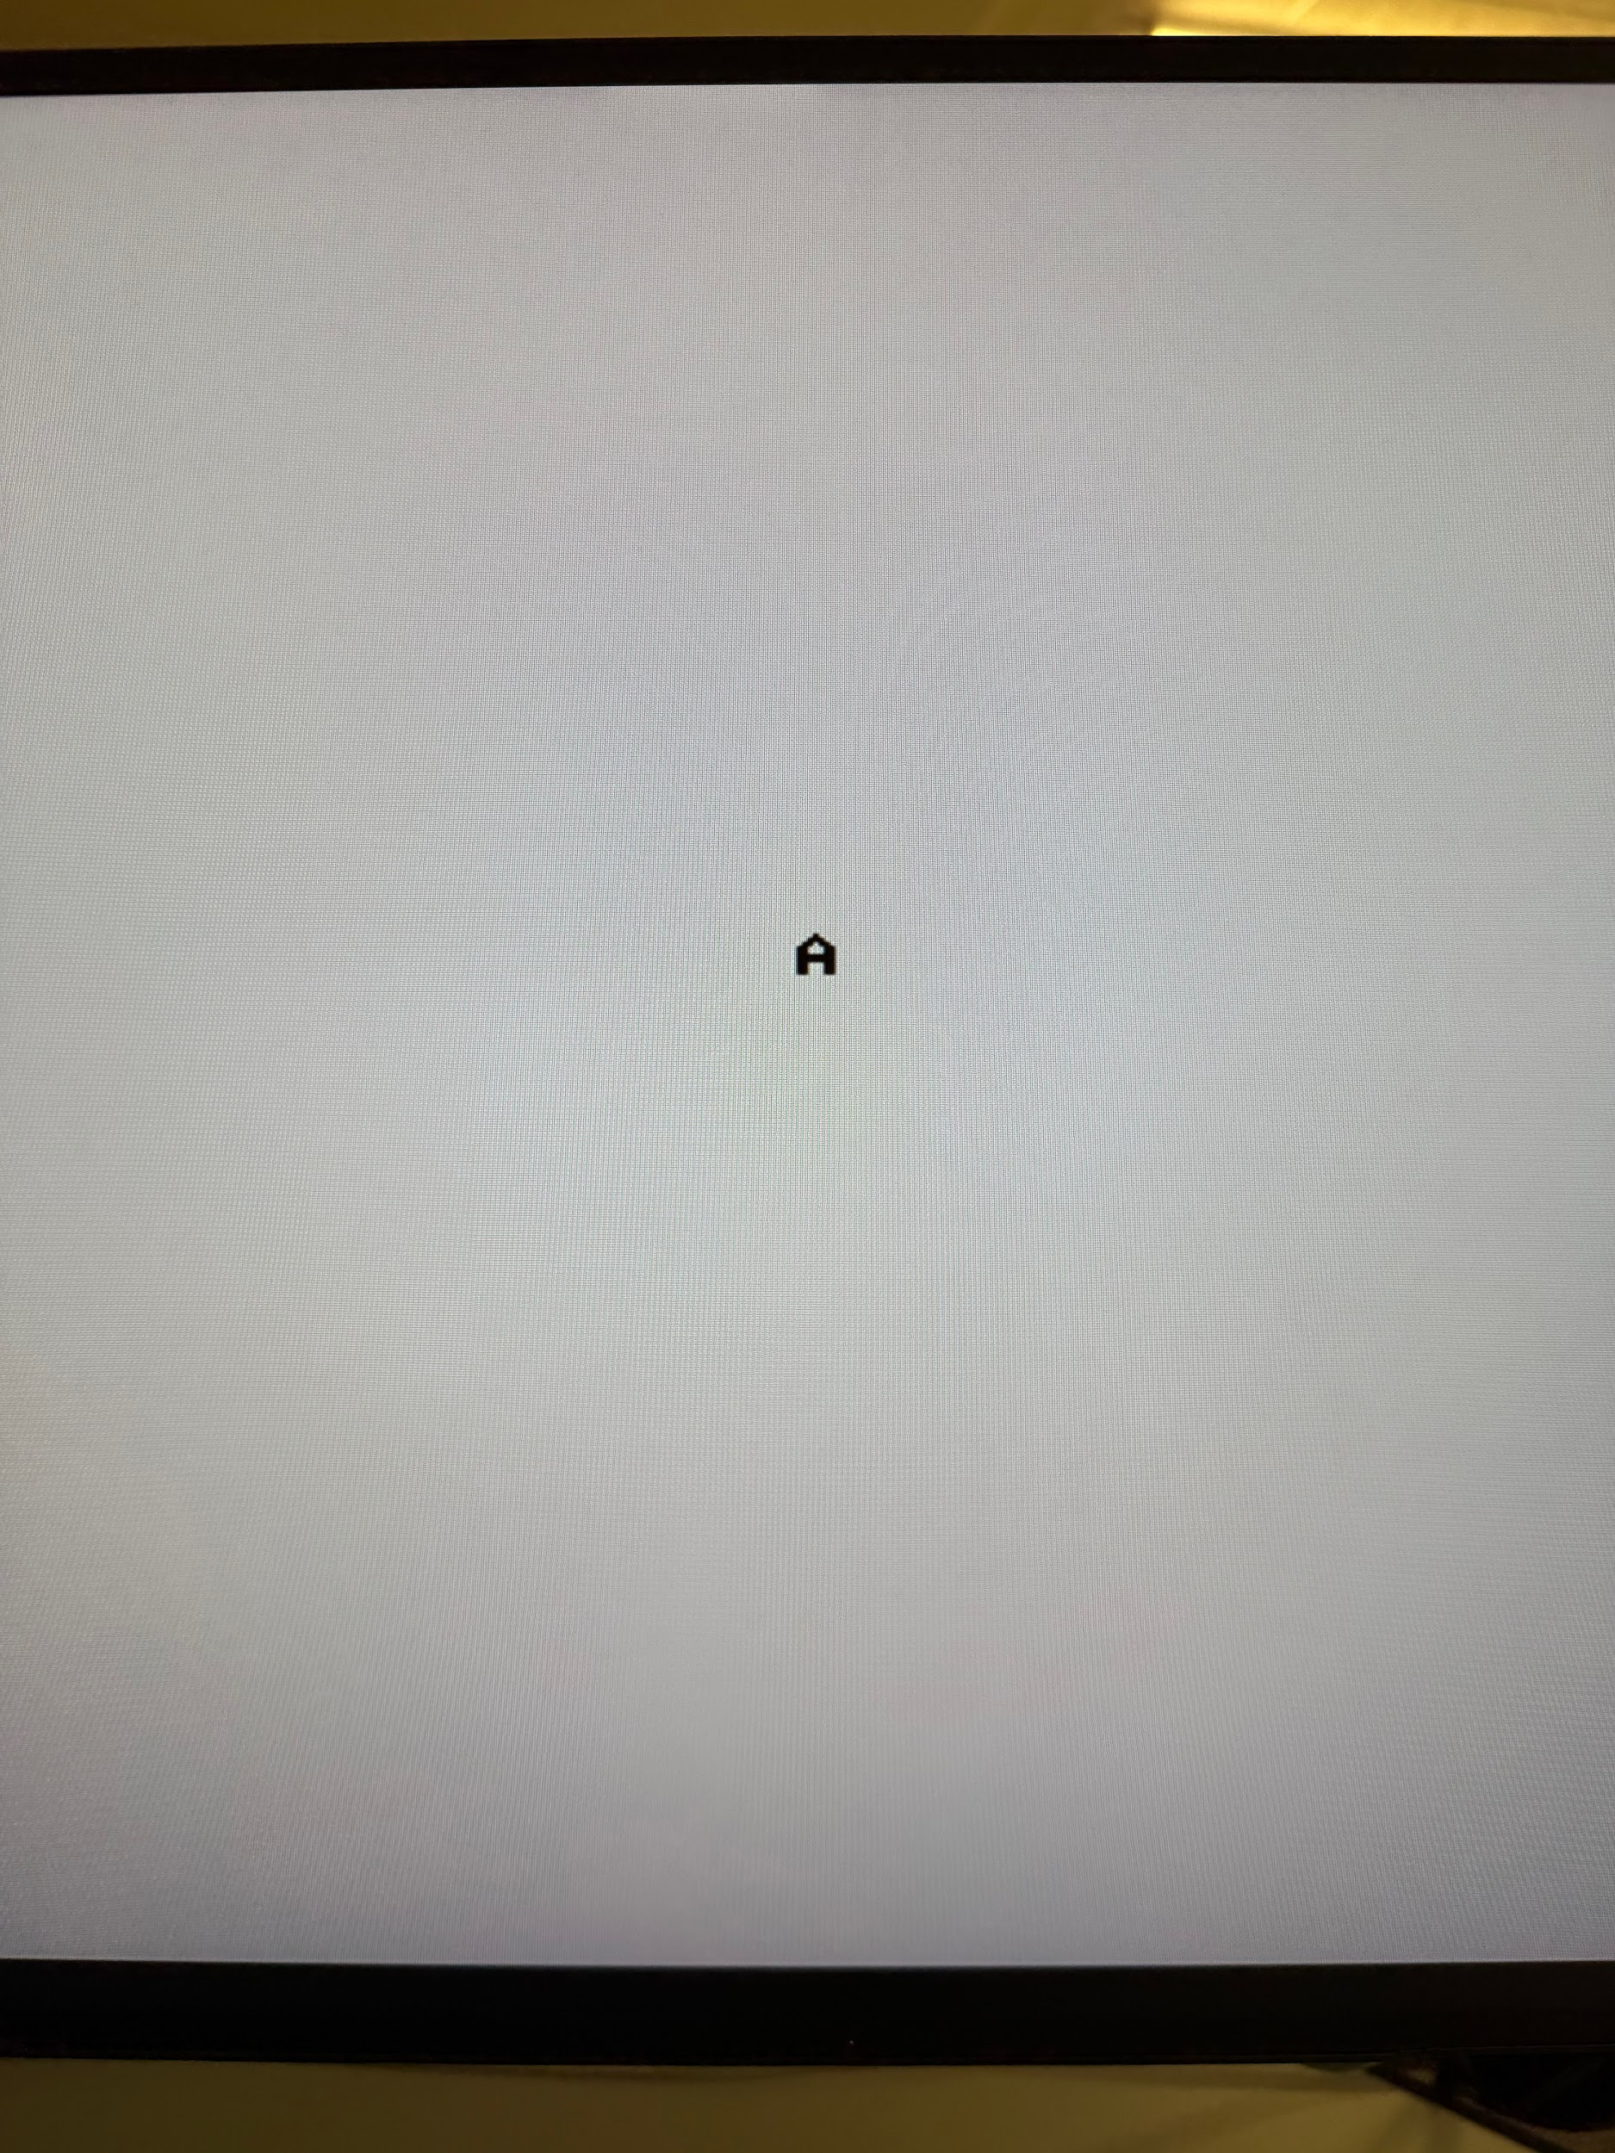
BLOCK DIAGRAM
Inputs
Dot Button
Button/Morse Code Receiver
Morse Code to ASCII
Letter
ASCII Value to corresponding VGA display value
Dash Button
Done Button
Reset Button
Letter Displays
Assign on pixels based on ascii input and pixel location
Check pixel location (x,y)
rgb_reg
x, y
ascii_bit
Notes:
Siara P.

Slide 6
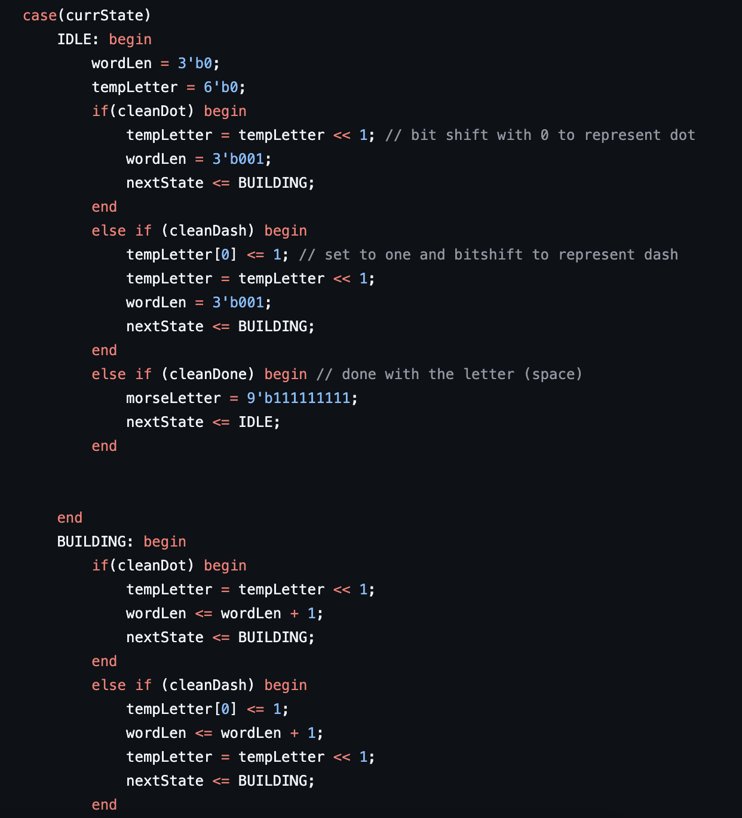
MORSE CODE: CODE SNIPPET
Notes:
Nathan

Slide 7
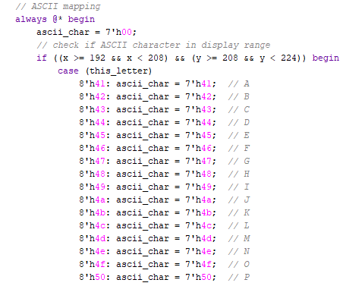
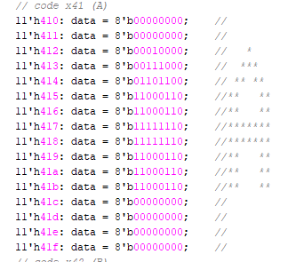
VGA DISPLAY: CODE SNIPPET
last 4 bits correspond to the rows
vga_test
vga_rom
we check the columns bit of the ROM data to see if pixel should turn on
this_letter input from morse code module corresponds to ROM data lines
centers the single letter on the screen
Notes:
Ella

Slide 8
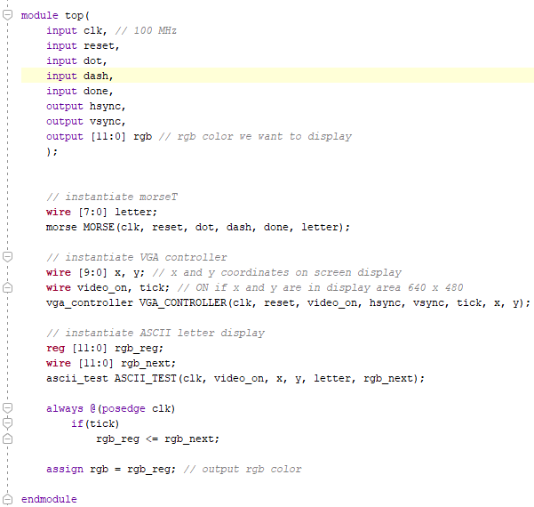
SUCCESS :)
All current modules interact
correctly with each other
Top
Morse Code Receiver
debouncer
vga_controller
ascii_test
ascii_rom
Notes:
Clutch conley

Slide 9
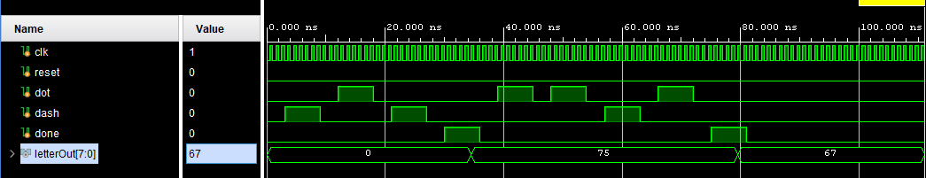
SUCCESS :)
Morse code almost fully functional
Testbench shows successful outputs, but FPGA does not work for all letters (dash button)
Notes:
nathan?

Slide 10
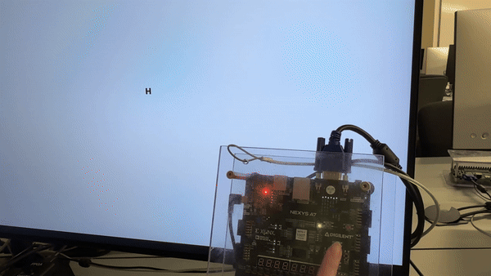
SUCCESS :)
Of the working letters, VGA displays them correctly
Almost done with practice mode
Notes:
Clutch conley

Slide 11
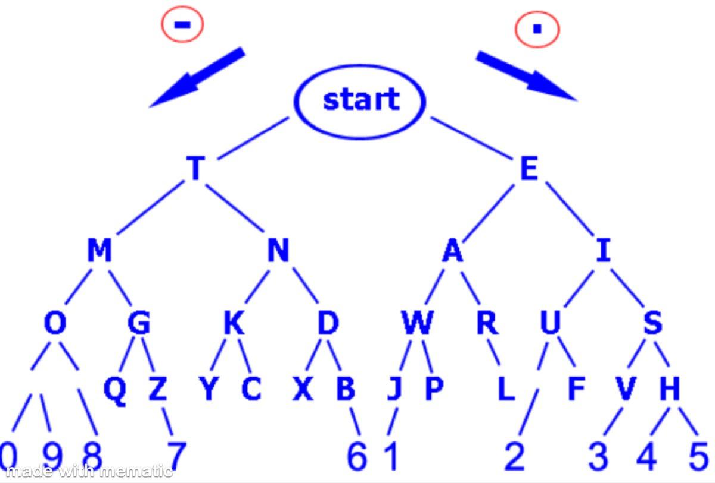
FAILURE :(
Need to get all of the letters working consistently and debug
Look into using trie data structure/FSM to build the letters?
Notes:
Nathan

Slide 12
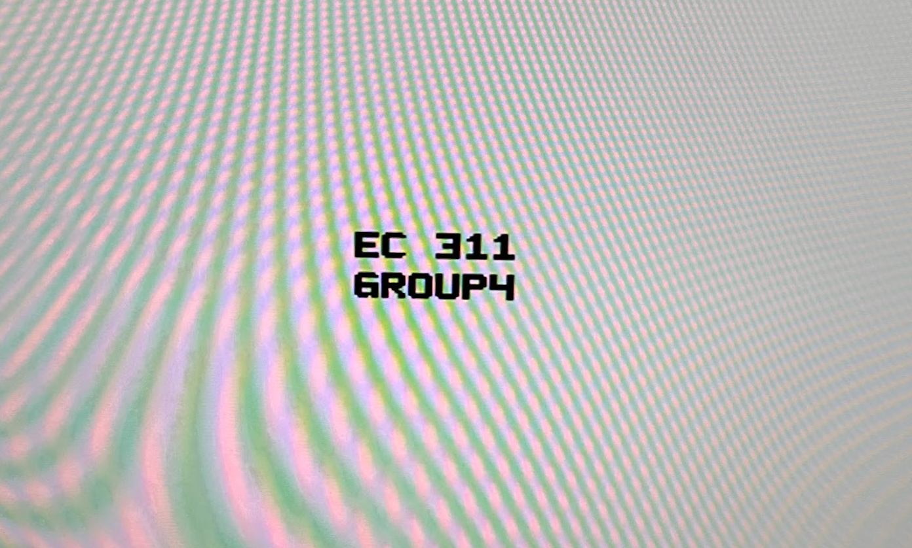
FAILURE :(
Still need to implement multiple letters on screen and develop a dynamic viewing window
640
192 193 194 195 196 197 198 199 200
h’410
313
314
315
316
317
318
319
320
321
322
323
324
325
326
327
328
8
.
.
.
16
h’416
480
.
.
.
.
h’41F
Notes:
Tyler

Slide 13
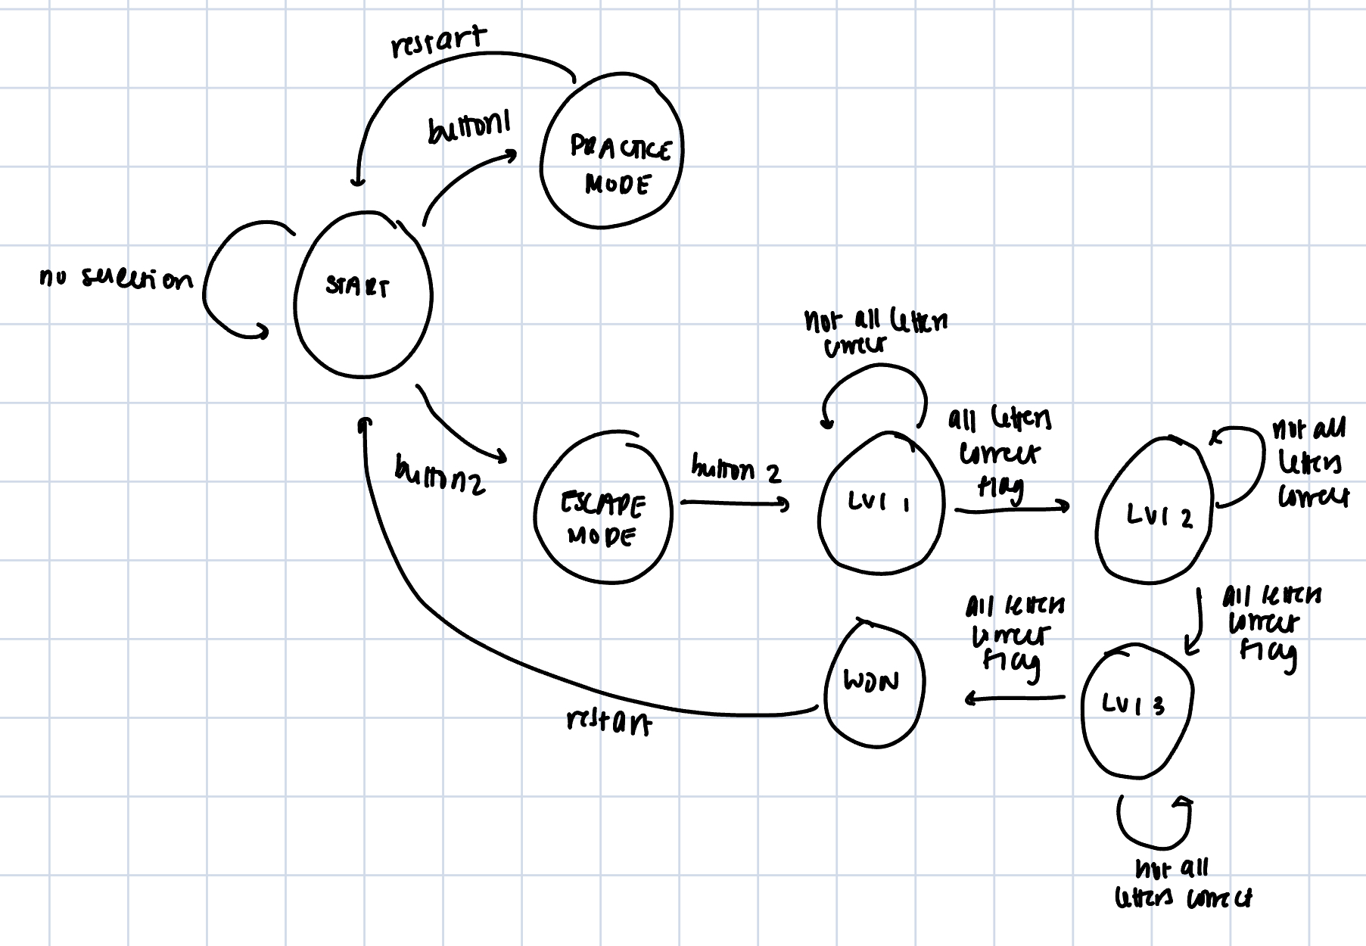

FAILURE :(
Still need a lot of escape game mode functionality
FSM for start menu, levels, end screen
Display pages for these states
Correct vs incorrect color indicators
Notes:
Ella

